Slide 1
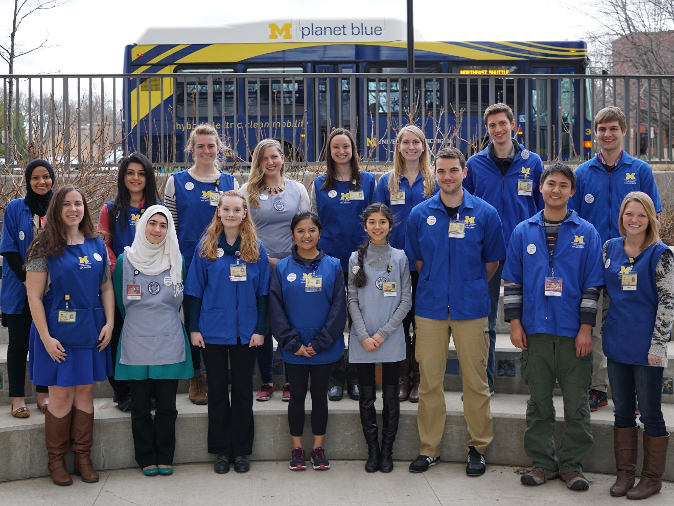
Hospital Elder Life Program (H.E.L.P)
Volunteer Satisfaction and Retention
Amanda Schoettinger, LBSW
Katie Thompson, LBSW

Slide 2
What is HELP?
A delirium prevention program for adults ages 65+ admitted to hospital
Volunteer based
Utilizes many different types of evidence based interventions
Hospital Elder Life Program (HELP)

Slide 3
Where did it start?
Yale University in the mid 90’s as a research project and then into a clinical pilot
Showed outcomes of decreased delirium, LOS, restraint usage, falls, and physical decline
Increased patient centered care for older adults
Increased staff satisfaction (reducing workload)
Hospital Elder Life Program (HELP)

Slide 4
How did it get to Michigan Medicine?
  How were we chosen?
  Requested to be a beta site
    2002
    2 inpatient units
Hospital Elder Life Program (HELP)

Slide 5
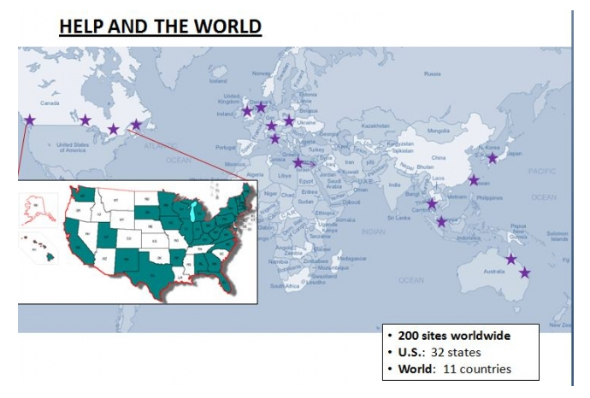
Current State
Hospital Elder Life Program (HELP)

Slide 6
Delirium defined
DSM V Criteria:
  A disturbance in attention and awareness
  Develops over a short period of time
  An additional disturbance in cognition
  Disturbances are not explained by another neurocognitive disorder (pre-existing and not)
  There is evidence that the disturbance is a direct physiological consequence of another medical condition.
    Systematic Response
Hospital Elder Life Program (HELP)

Slide 7
Delirium in the Acute Care Setting
Of older in-patients, 60% will develop delirium
  Associated with poor outcomes
    increased morbidity
    mortality
    prolonged LOS
    Institutionalization
    functional decline
Hospital Elder Life Program (HELP)

Slide 8
Current impact of delirium
35% of US population age 65 and older are hospitalized, account for > 40% of all inpatient days annually
(assuming a delirium rate of 20%)
  7% of all persons > 65 years will develop delirium annually
  delirium will complicate hospital stay for > 2.2 mil persons involving > 17.5 mil inpt days
estimated costs > $8 billion /yr - hospital costs only (not including pt cost)
Hospital Elder Life Program (HELP)

Slide 9
Hyperactive delirium
Demonstrate features of restlessness, agitation, hyper vigilance and often experience hallucinations and delusions. May begin pulling catheters or tubes, hitting, biting, and emotional changes.
Characteristics
  Increased psychomotor activity.
  mixed fast and slow frequencies on EEG.
  excitability, hyper arousal of autonomic system.
  agitated, belligerent, restless.
  pressured speech, loud.
  Psychotic tendencies.
Hospital Elder Life Program (HELP)

Slide 10
Hypoactive Delirium
Present with lethargy and sedation, respond slowly to questioning, and show little spontaneous movement.
Can be withdrawn, have flat affect, apathy, and perhaps even unresponsiveness; often unrecognized due to these “quiet” symptoms
Characteristics:
  Decreased psychomotor activity.
  diffuse slowing on EEG.
  Apathy.
  Lethargic, drowsy, quiet, calm.
  Responds slowly to questions.
Hospital Elder Life Program (HELP)

Slide 11
It is NOT Depression
Quiet delirium
  Resembles depression: unmotivated, withdrawn, slow, undemanding (poor executive function)
  BUT depressed patients are NOT classically inattentive
  Possible similar neurophysiology signs
Hospital Elder Life Program (HELP)

Slide 12
It is NOT Dementia
Time course
Severe inattention of delirium unlikely except in late stage dementia
Looks like it but is much more sudden and is reversible
Hospital Elder Life Program (HELP)

Slide 13
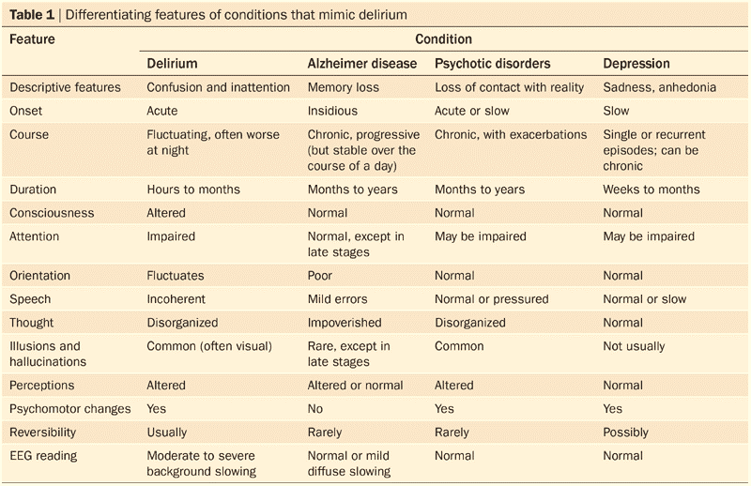
Table 1 Differentiating features of conditions that mimic delirium
Fong TG et al. (2009) Delirium in elderly adults: diagnosis, prevention and treatment
Nat Rev Neurol doi:10.1038/nrneurol.2009.24
Hospital Elder Life Program (HELP)

Slide 14
Risk factors of delirium
Cognitive impairment
Sleep deprivation
Immobilization
Vision impairment
Hearing impairment
Dehydration BUN/Cr ratio > 18
Ref: Inouye SK, et al. N Engl J Med. 1999;340:669-7
Hospital Elder Life Program (HELP)

Slide 15
Confusion Assessment Method (CAM)
1. Acute onset of mental status changes
or a fluctuating course
and
2. Inattention
and
3. Disorganized
Thinking
4. Altered level of
consciousness
or
= Delirium
Hospital Elder Life Program (HELP)

Slide 16
Goals of the Elder Life Program
Identify older patients with risk factors of delirium: dehydration, cognitive impairment, ADL deficits, sensory impairment
Maintain physical and cognitive functioning throughout hospitalization.
Maximize independence at discharge.
Improve geriatric skills of staff.
Hospital Elder Life Program (HELP)

Slide 17
HELP Demographics
Program exists on 10 inpatient units
All patients >65 with expected LOS >48hrs days are screened daily
Social Worker collaborates with HELP CNS and creates and supervises a care plan for the volunteers.
Hospital Elder Life Program (HELP)

Slide 18
Inclusion
Age 65 years and older
Inpatient on hospital unit 5A, 5B, 5C, 6B, 6C, 7A1, 7B, 7C, 8B, or 8C
At least one risk factor for cognitive or functional decline:
--Cognitive Impairment—MMSE <24/30 (or equivalent ratio) or failed Mini-Cog Test
--Any mobility or ADL impairment
Includes pain & weakness if affects function
--Vision impairment: <20/70 best corrected vision
--Hearing Impairment: <3 of 6 whispers in each ear on Whisper Test
--Dehydration: BUN/Cr ratio >18
Able to communicate verbally or in writing in English.
-- Nonverbal patients who can communicate in writing are included.
Anticipated Length of Stay greater than 48 hours
Mental health conditions if affects function
Hospital Elder Life Program (HELP)

Slide 19
Exclusion
Coma
Mechanical ventilation
Aphasia (expressive and/or receptive) if communication ability is impaired
Terminal condition with comfort care only, death imminent
Combative or dangerous behavior
Severe psychotic disorder that prevents patient from understanding and/or
participating in interventions
Severe dementia (e.g., unable to communicate; MMSE = 0)
  For those with severe impairment (MMSE <10), decision to enroll will be made on case-by-case basis depending on their ability to participate in interventions
Respiratory isolation or droplet precautions
  Other precautions on case-by-case basis
Discharge firmly anticipated within 48 hours of screening
Refusal by patient, family member (if patient is incompetent)
Hospital Elder Life Program (HELP)

Slide 20
Elder Life Interventions
Daily visitor program of cognitive orientation.
Therapeutic activities.
Early mobilization.
Non-pharmacologic sleep protocol/relaxation.
Hearing and vision protocol.
Nutrition and fluid intake assistance.
Hospital Elder Life Program (HELP)

Slide 21
Why does it work?
Different interventions have different effects on the brain
Food and fluid repletion intervention
  Prevention of dehydration
  Nutrition in general
Hearing/vision Intervention
  Without appropriate sensory input, the mind can misinterpret the environment
Mobility Intervention
  Enhances the overall well-being
Therapeutic Interventions
  Provides brain stimulation
Hospital Elder Life Program (HELP)

Slide 22
Benefits of HELP at University Hospital
Improved patient and family satisfaction.
Reduced interruptions and demands on professional staff.
Higher nursing satisfaction.
Consistent with mission and vision.
Promotes quality initiatives in patient safety.
Hospital Elder Life Program (HELP)

Slide 23

Volunteerism at it’s finest
Hospital Elder Life Program (HELP)

Slide 24
Who Does the Work?
Highly Trained Volunteers
  Students
  Community members
Training Components
  Initial training
  Shadowing
  On-going monthly education
  Competencies Checks
Hospital Elder Life Program (HELP)

Slide 25
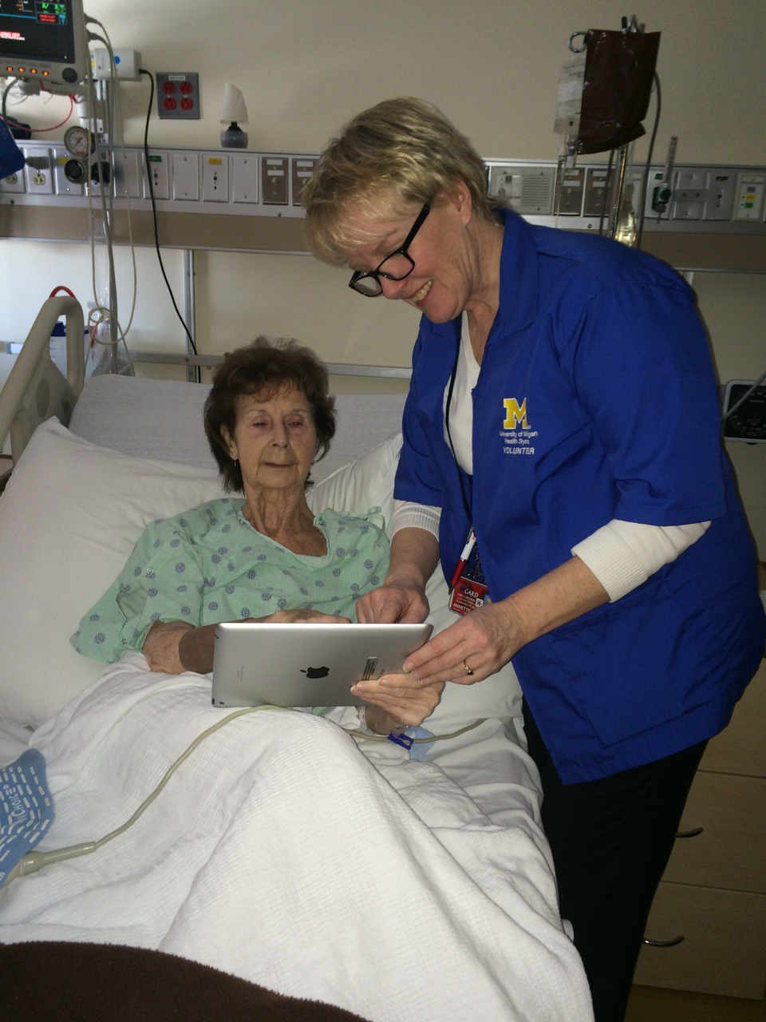
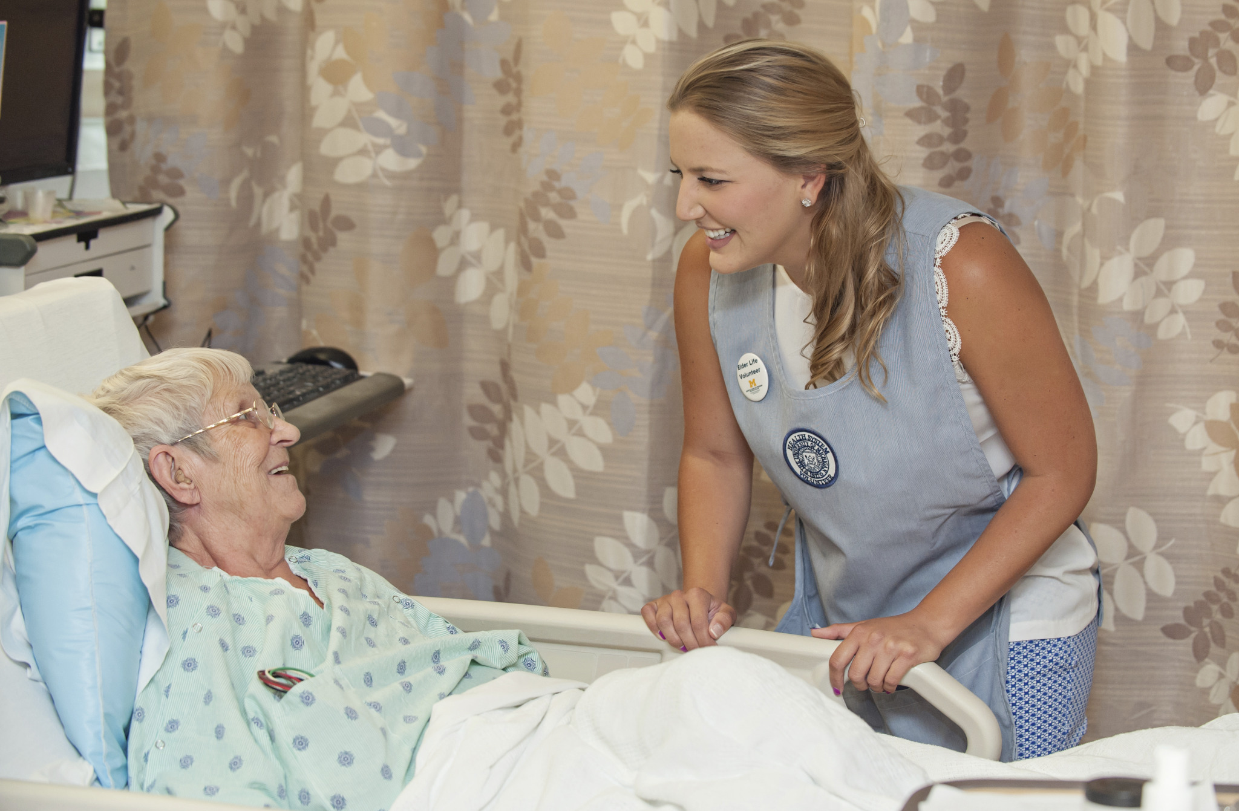
Our team
Hospital Elder Life Program (HELP)

Slide 26
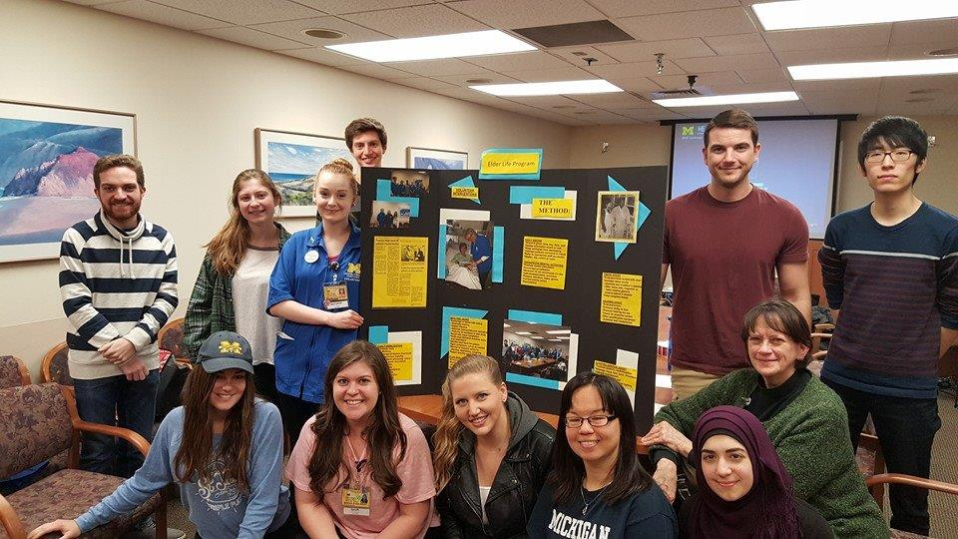
More team members
Hospital Elder Life Program (HELP)

Slide 27
Program Growth
In the last three years, went from 4 to 10 units and 8 to 102 active volunteers
From an average of seeing 252 pts per year to seeing 795 pts last year
Currently providing 18,192 total interventions per year
Hospital Elder Life Program (HELP)

Slide 28
Reasons for the Growth
Organizational Reach
  Facilitate discussions with nurse managers and other unit staff
  Collaboration between hospital departments
Community Outreach
  EMU Vision and UM Ginsberg
  Local churches, senior centers
  Volunteer Match, Washtenaw Org
Hospital Elder Life Program (HELP)

Slide 29
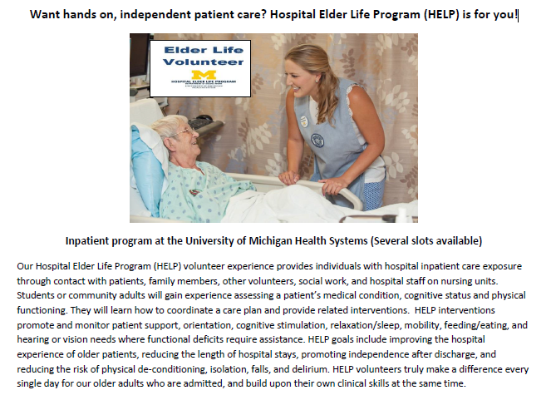
Volunteer Match
Hospital Elder Life Program (HELP)

Slide 30
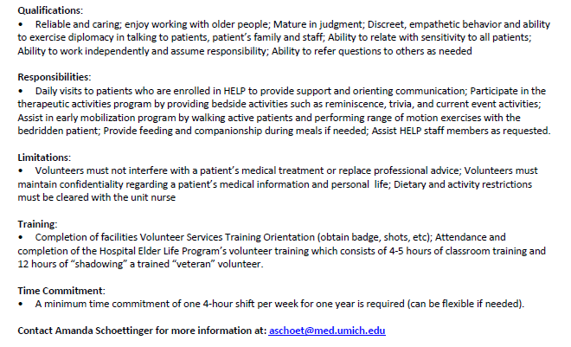
Volunteer Match
Hospital Elder Life Program (HELP)

Slide 31
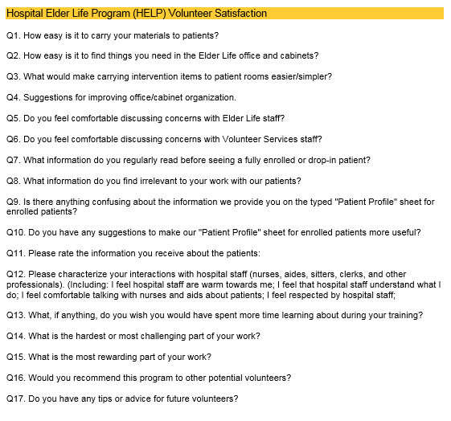
Volunteer Survey
Hospital Elder Life Program (HELP)

Slide 32
Volunteer Motivation
Purpose
  Healthcare focused
  Community hours required
  Personal
Accomplishments
  Skill building
  Use of personal strengths
Autonomy
  Independence and trust
Social
  Connectedness with others
Hospital Elder Life Program (HELP)

Slide 33
Volunteer Retention
Communication and Engagement
  360 degree leader
  Monthly team meetings
  Bi-Monthly check-ins
Opportunity for Leadership
  Team Leads
Hospital Elder Life Program (HELP)

Slide 34
Volunteer Retention con’t
Acknowledgements
  Birthday cards
  Making a Difference Awards
  Volunteer of the Quarter Award
  Scholarships
Hospital Elder Life Program (HELP)

Slide 35
Benefits of Volunteers for HELP
They have the time and want to give it
More volunteers = more individuals impacted
Different level of trust with volunteers
Learned skills carry into the future
Hospital Elder Life Program (HELP)

Slide 36
Volunteer Quotes
“For me, HELP is a beautiful representation of human interaction. We not only help the patients but they help us in return. Being part of a younger generation, they willingly provide glimpses into the happy secrets of life from their cherished memories. Tapping into those memories is what keeps their spirits lifted at a time when it is challenging to do on their own.” - Ashley Grable
"HELP is an incredibly inclusive and supportive program to be a part of. Our program Manager, Amanda, is positively invested in the personal and professional growth of all HELP's volunteers. She uses monthly team meetings to provide additional trainings and lectures to further our skills as part of the patient's care team while providing guidance and support through an ever-changing healthcare field. HELP has been an absolutely transformative experience." – ML Ryan
“It’s easy to enjoy HELP because of the great support from Amanda and the nurses and clerks on the floor. One of my favorite moments in HELP is when I see patients pushing themselves through the exercises, where I could see their strength of spirit. It’s encouraging and uplifting and makes me excited about my next shift.” – Erin Santos
Hospital Elder Life Program (HELP)

Slide 37
Volunteer Quotes
"I really enjoy how Amanda encourages volunteers to strive to be their best by celebrating with them when getting positive feedback from patients and staff members, and also by sharing tips for improvement moving forward."
– Rachel Price
“HELP is an amazing volunteering opportunity because it is centered around patient interaction, and you are given so many chances to actively listen to your patients. Amanda is so responsive to feedback and emails, and she genuinely cares about the well-being of the patients and volunteers”. – Andie Kwon
“I truly enjoy receiving emails from Amanda asking for team lead projects to be completed. In med school, everything seems negative around you as all of the focus is how you should be doing something better, how you got this or that wrong, how someone else is better than you, and it’s defeating. One email from Amanda makes me feel like she believes in me and it’s all going to be worth it.” – Grace White
Hospital Elder Life Program (HELP)

Slide 38
Patient/Family Quotes
“I loved every visit I got and it actually made my stay less scary. I really like the U of M now that I get special care taken of me by these nice volunteers.”
“Volunteers were always GREAT! “
“Everyone my father had contact with was wonderful.”
“I think in the absence of a family member, the volunteer may notice a change in cognition which could be significant. My mom has baseline dementia and I can tell you that her admission prior to this stay, she did experience delirium and hallucinations. It was awful but she DID NOT experience delirium with this last hospitalization with HELP seeing her. So thankful that you provided her this service.”
“If I am able, I will go to the U of M if I have a need because of this program.”
Hospital Elder Life Program (HELP)

Slide 39

Any Questions?
Hospital Elder Life Program (HELP)

