Slide 1
HAND MASSAGE POSITIONS
Cathrine Weaver, MSN, HN-BC, RN
Lee Ball, LMT
A special thanks to our volunteer hand model, Bernice Prewitt

Slide 2
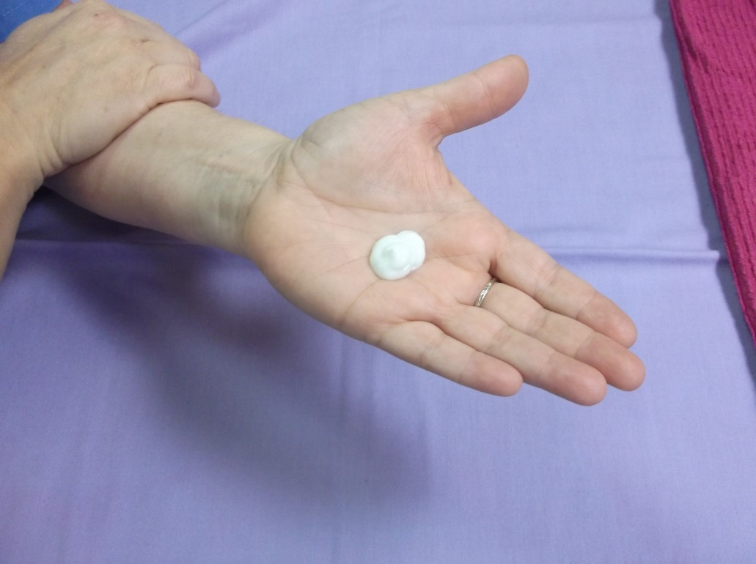
Amount of Lotion Needed

Slide 3
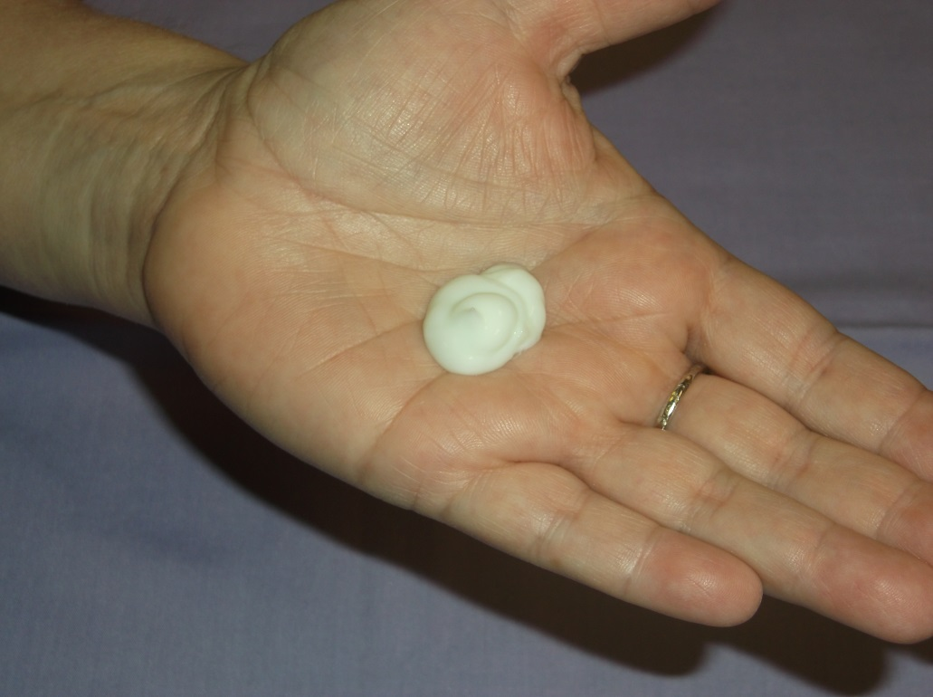
Just A Dab’ll Do Ya

Slide 4
Starting Position

Slide 5
Spreading

Slide 6
Track

Slide 7
Track Progression

Slide 8
Finding Track

Slide 9
FindingTrack

Slide 10
Lobster

Slide 11
Lobster – Palm View

Slide 12
L-Hold

Slide 13
L-Hold

Slide 14
L-Hold

Slide 15
Base of Finger

Slide 16
Base of Finger

Slide 17
Driftaway

